Slide 1

Classifying Nba players by position based on yearly statistics
Data Science Inquiry by Brian Caterfino

Slide 2
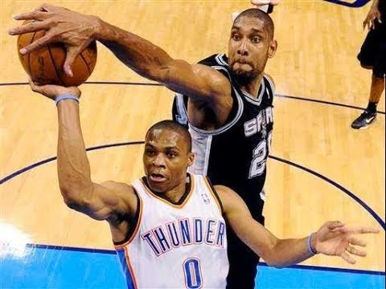
Important Background information
Positions
Point Guard
Shooting Guard
Small Forward
Power Forward
Center
Important Statistics
3P, 3PA, 3P% - 3 Point/ Attempts/ Percentage
TRB, ORB, DRB – Total/ Offensive/ Defensive Rebounds
AST, STL, BLK – Assists, Steals, Blocks
AST/TOV – Assist Turnover Ratio

Slide 3


The Process
Obtain Data
Scrub Data
Explore Data
Model Data
Interpret Data

Slide 4
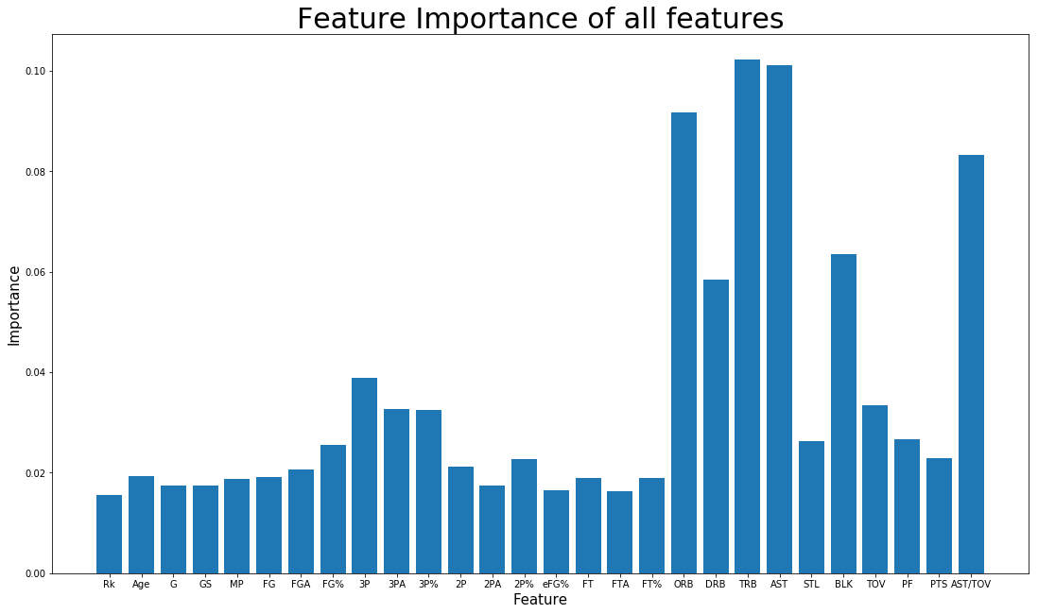
Selecting which stats to include in the model
Most important features:
TRB, AST, ORB, AST/TOV, BLK
DRB, 3P, 3PA, 3P%, TOV

Slide 5
Does my classifier work better with 3 positions (Guard, Forward, Center) or all 5?
3 Positions or 5 Positions?

Slide 6
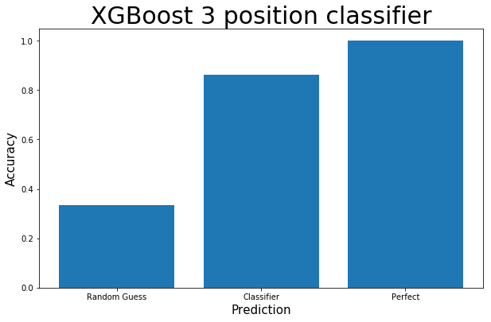
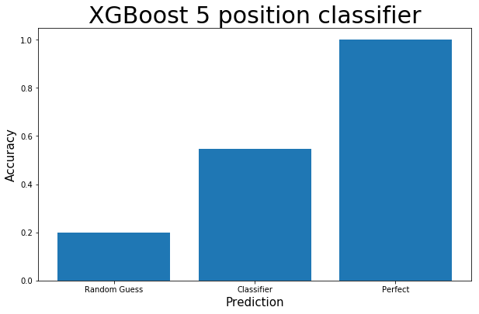
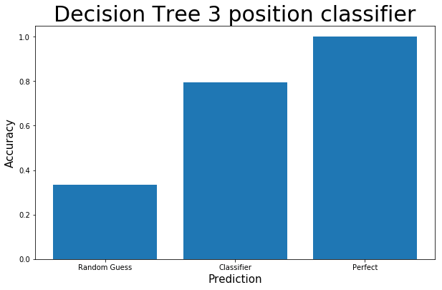
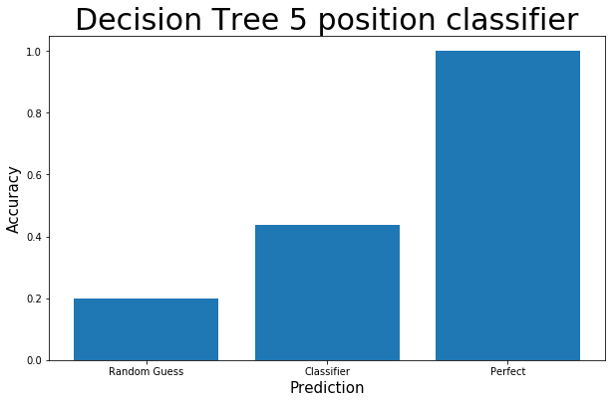
An ensemble of ensembles: Which ensemble classifier performed best?

Slide 7
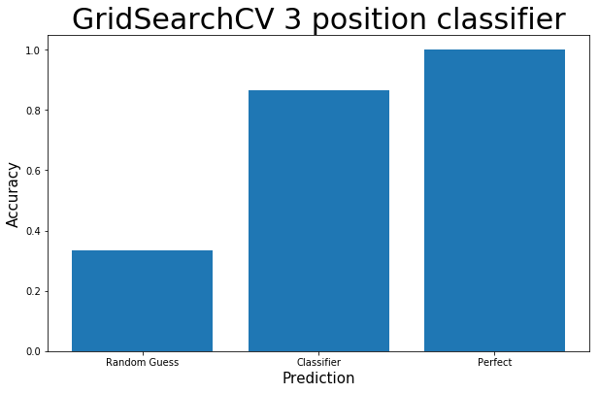
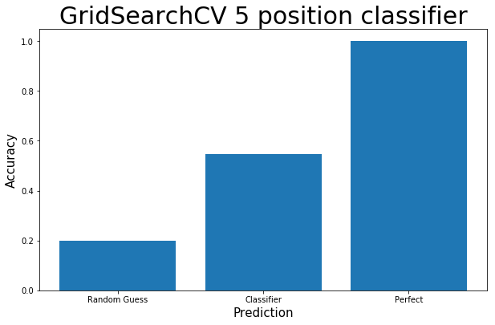
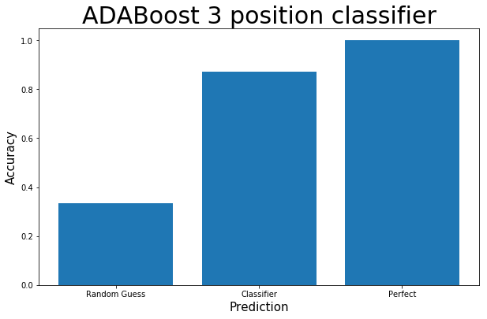
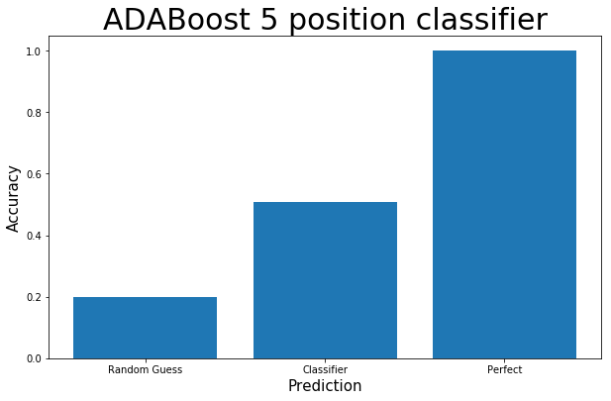
An ensemble of ensembles: Which ensemble classifier performed best?

Slide 8
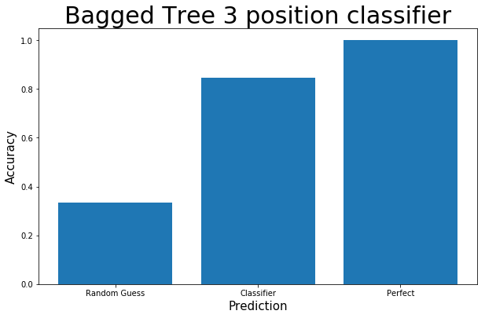
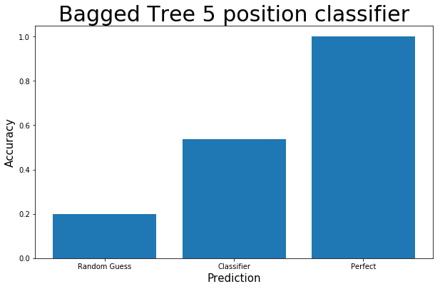
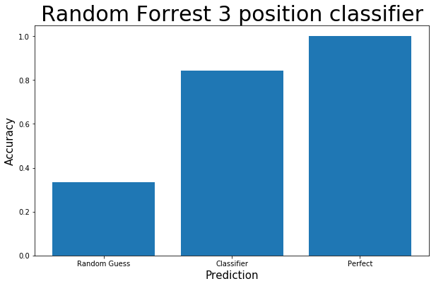
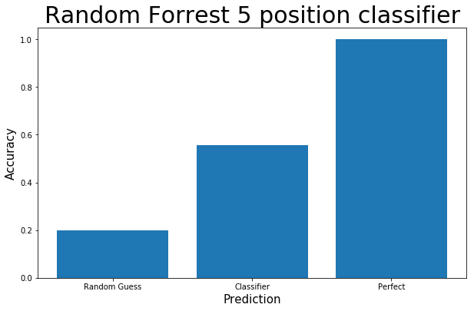
An ensemble of ensembles: Which ensemble classifier performed best?

Slide 9

Conclusions
The most important non-colinear statistics in classifying position are:
ORB, 3P%, AST
The 5 position classifier performs around 30% better than random selection
The 3 position classifier performs around 50% better than random selection
Yearly statistics are more accurate when classifying simplified positions (3) than all positions (5)

